Slide 1


Presentation & Updates
Olivier Bergeron

Slide 2

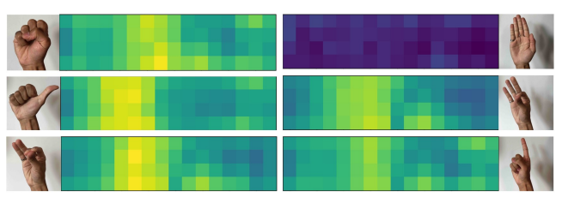
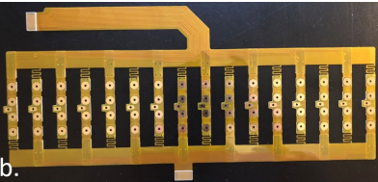
Project Presentation
EMaGer: Spatial EMG activation maps with 64 electrodes
F. Chamberland et al., « EMaGer: A Wearable Full-Circumference HD-EMG Sensor and Data Augmentation Method for Robust Hand Gesture Recognition », in 2023 45th Annual International Conference of the IEEE Engineering in Medicine & Biology Society (EMBC), Sydney, Australia: IEEE, juill. 2023, p. 1‑5. doi: 10.1109/EMBC40787.2023.10340612.

Slide 3
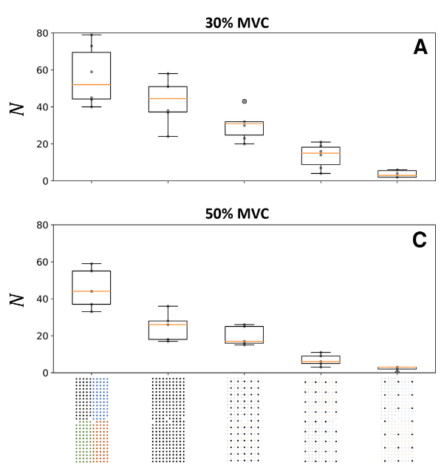
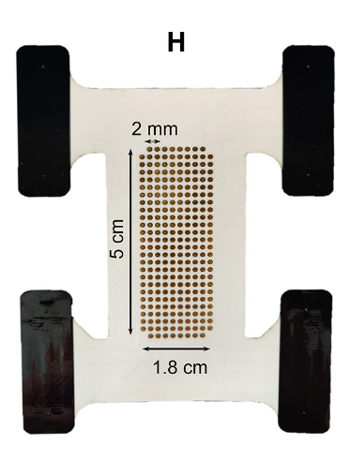
Project Presentation
Hypothesis: More channels would result more recognisable gestures.
A. H. Caillet et al., « Larger and Denser: An Optimal Design for Surface Grids of EMG Electrodes to Identify Greater and More Representative Samples of Motor Units », eNeuro, vol. 10, nº 9, p. ENEURO.0064-23.2023, sept. 2023, doi: 10.1523/ENEURO.0064-23.2023.

Slide 4
Project Presentation
Electrode Grid
Analog Front End (AFE)
Analog to Digital Converter (ADC)
Post-processing
(MUAP Decomposition)
FPGA

Slide 5

Project Presentation
Electrode grid: Custom made
Grid size: 7 x 51 (357 total)
Electrode dimensions: $\sim$ 2.5 mm
Inter-electrode distance (IED): $\sim$ 5 mm (Circ.) and $\sim$ 10 mm (Long.)
AFE & ADC:
High number of channels (448 or 512)
Hardware options: Pre-made (TMSi, OT Bioelettronica, etc.), custom with INTAN or fully custom.
Post-processing
Hardware not fully defined but gravitate towards GPU.

Slide 6
Updates
PEDOT process:
Found interesting articles.
Will send them to Ricardo to review.
Prototype quotes:
TMSi: Want to set up a meeting to discuss.
OT Bioelettronica: Affordable grid, but not the acquisition module

Slide 7
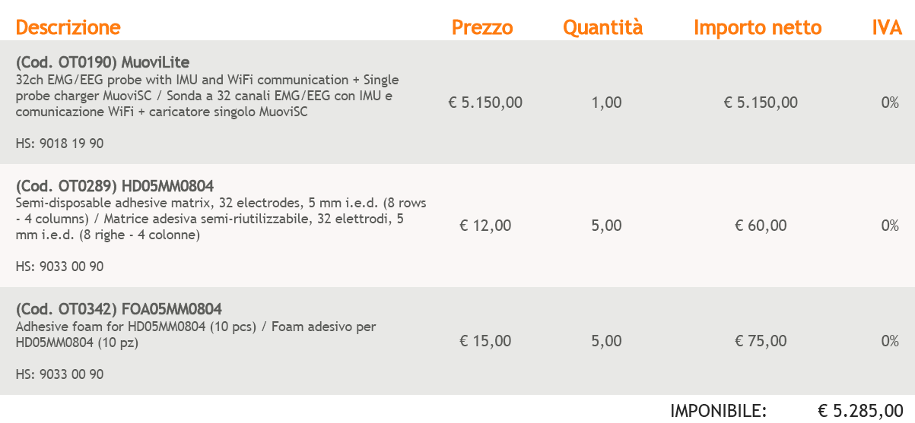
Updates

